Slide 1

Design patterns

Slide 2

Factory pattern
When
Creating complex object
SOLID (OCP, DIP)
Hiding switch cases
Examples
Calculators
RepositoryRegistry
DBProvider (Abstract Factory) + Tests
Angular
Games
IoC
RedshiftORM -> Dynamic return default Value

Slide 3
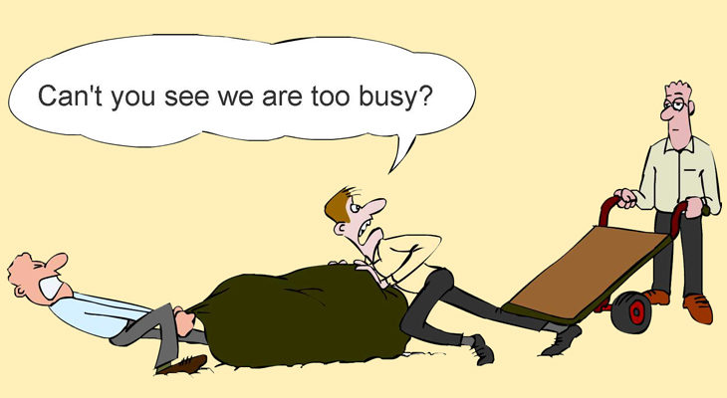
Strategy Pattern
When
To plug in “strategies”
SOLID (SRP, OCP, DIP)
Composition over inheritance
https://www.youtube.com/watch?v=wfMtDGfHWpA
Example
Calculator
Click Strategies
Events schedule
Medical Events Scheduler
Games

Slide 4

Façade Pattern
When
To hide the complexity and to provide simple interface
SOLID (ISP, SRP, DIP)
To hide a workflow under simple interface
The big three again
Help us to follow SRP with separating
responsibilities into classes
Example
Click handlers
Payment workflow
API Gateway
Hotel

Slide 5

Mediator Pattern
When
To avoid coupled code (when we have M:N connections)
SOLID (OCP, DIP)
Example
Filters Layout
Chat room
No more money
With Observables
Waiters to Chefs

